Slide 1


AtliQ Hospitality Analysis

Slide 2
Problem Statement:
AtliQ Grands owns multiple five-star hotels across India. They have been in the
hospitality industry for the past 20 years.
Due to strategic moves from other competitors and ineffective decision-making in management, AtliQ Grands are losing its market share and revenue in the luxury/business hotels category.
As a strategic move, the managing director of AtliQ Grands wanted to incorporate “Business and Data Intelligence” in order to regain their market share and revenue.

Slide 3
Objectives:
To check most revenue is generated from which city.
To check hotels most booked in which city.
How much total revenue and average revenue generated by hotels.
To check month wise total bookings.
To check which city generated lowest revenue.
To check which room category generates most revenue.

Slide 4
Details of Data:
We are provided 3 months booking details data of all the atliQ hotels.
Dataset contains 5 excel files.
dim_date
dim_hotels
dim_rooms
fact_aggregated_bookings
fact_booking
Metric list excel file

Slide 5
Architecture:
Collect Raw Data → Importing Libraries → Load Dataset → Merging Data → Assessing Data → Handling Missing Data → Adding Columns → Exploring Data → Modeling → Creating Measures → Tableau Report → Insights

Slide 6
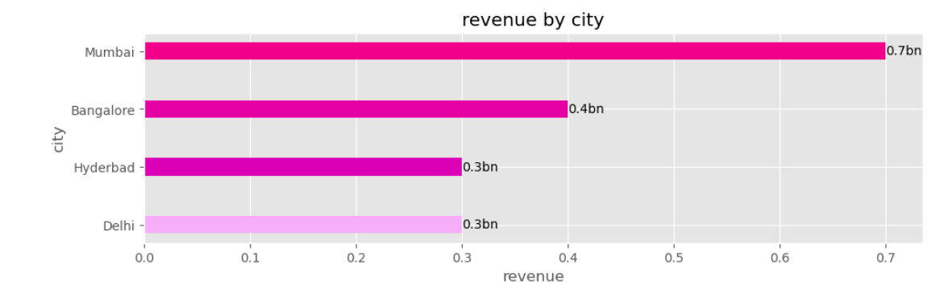
Some Important Insights:
Most revenue is generated from Mumbai city.

Slide 7
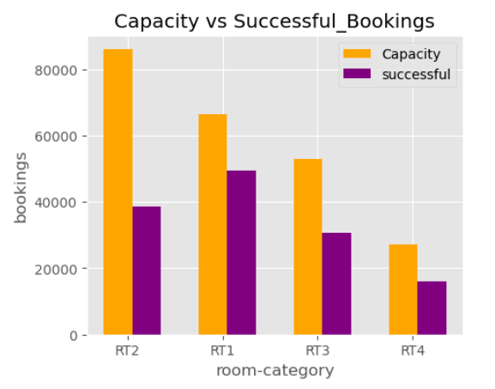
Some Important Insights:
Max revenue generated among room categories is by RT2 by 32.84%

Slide 8
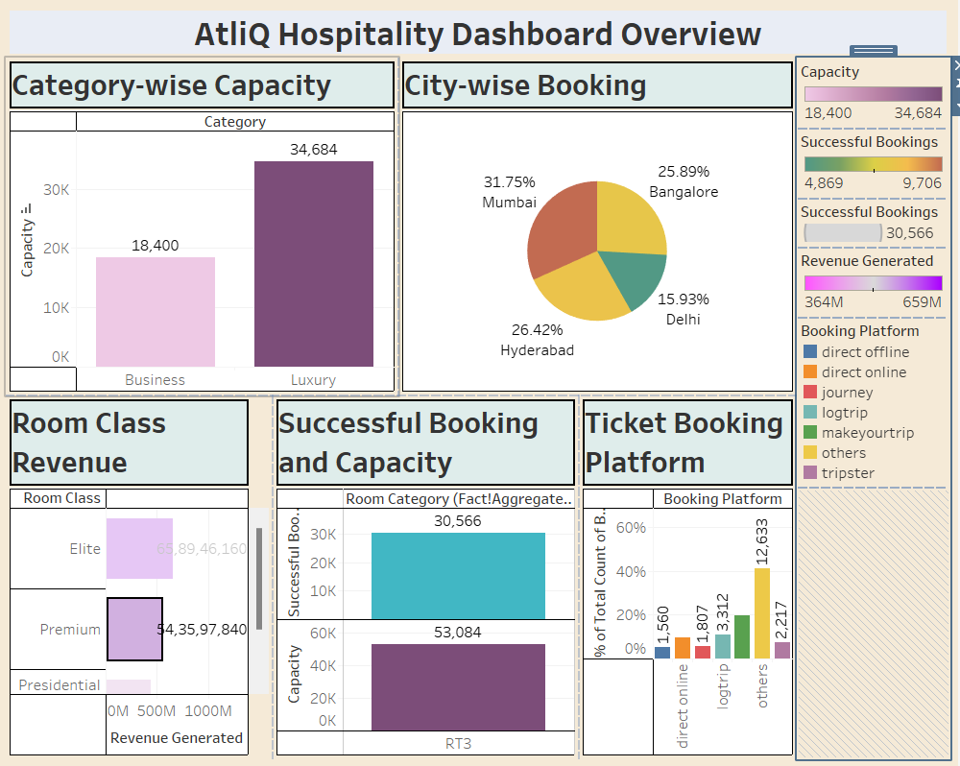
Dashboard:

Slide 9
Key Performance Indicator:
▪ Mostly booked hotels
▪ Average revenue and total revenue
▪ Revenue generated by city
▪ Mostly booked hotels by city
▪ Total bookings in past 3 months
▪ Total occupancy in past 3 months
▪ lowest revenue
▪ Average ratings to hotels
▪ Maximum revenue by room category

Slide 10
Conclusion:
▪ A sizable portion of the clientele is made up of people between the ages of 40 and 59
▪ The year 2016 saw an exponential surge in sales
▪ High quantity of products is ordered from Australia and United States
▪ Major Profit is contributed by the Bike Category
▪ The average order has a gap of 7 days between the day the order is ready for export from the factory and the date it was shipped
▪ Maximum profit earned in the months of June, November, and December ▪ High sales orders are seen on Wednesday and Saturday, when compared to other weekdays
▪ There is a high negative correlation between Price and number of Quantity ordered

Slide 11


Thank You.

